Slide 1


Course Code : CSE443
Summer Training PowerPoint Presentation
Topic:
Machine Learning
and AI
Name: Harsh Mishra
Program: B. Tech. CSE
Organization: Board Infinity
LOVELY PROFESSIONAL UNIVERSITY
PHAGWARA, PUNJAB

Slide 2
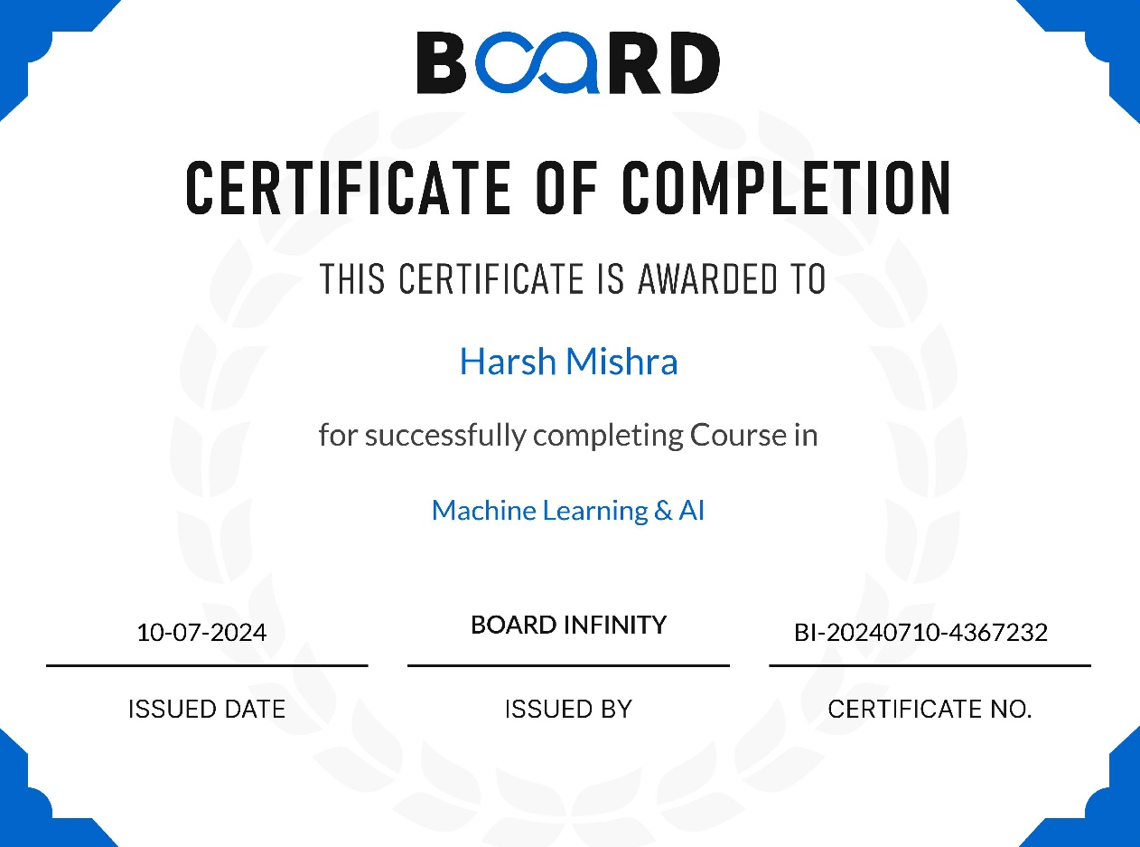
Objective
To gain practical experience in Machine Learning and AI, enhancing my full-stack web development skills by incorporating innovative techniques into future projects, recognizing the growing importance of machine learning in technology.
Certification

Slide 3
Outline
What is Machine Learning and AI?
Types of Machine Learning
Supervised Learning
Regression
Classification
Unsupervised Learning
Clustering
Final Project: California House Price Prediction

Slide 4








Tools Learnt
Python:
Essential programming language for implementing machine learning models and algorithms.
Pandas:
Used for preprocessing and organizing data to prepare it for machine learning models.
Scikit-learn:
Key library for building, training, and evaluating machine learning models such as regression, classification, and clustering.
Jupyter Notebook:
An interactive environment for writing and running Python code, ideal for developing and testing machine learning models.
Google Colab:
A cloud-based platform that allows for collaborative coding and access to GPU resources, making it easy to train machine learning models.

Slide 5

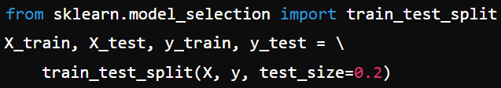

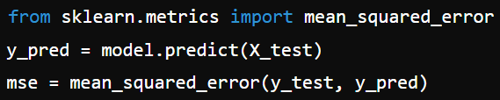
Scikit-Learn Workflow
1. Data Preprocessing:
Load the dataset and separate it into features (X) and target (y).
2. Split the Data:
Use train_test_split to divide the data into training and test sets.
3. Model Training:
Initialize and train the model, such as Linear Regression.
4. Model Evaluation:
Make predictions and evaluate the model's performance using metrics like Mean Squared Error (MSE).

Slide 6
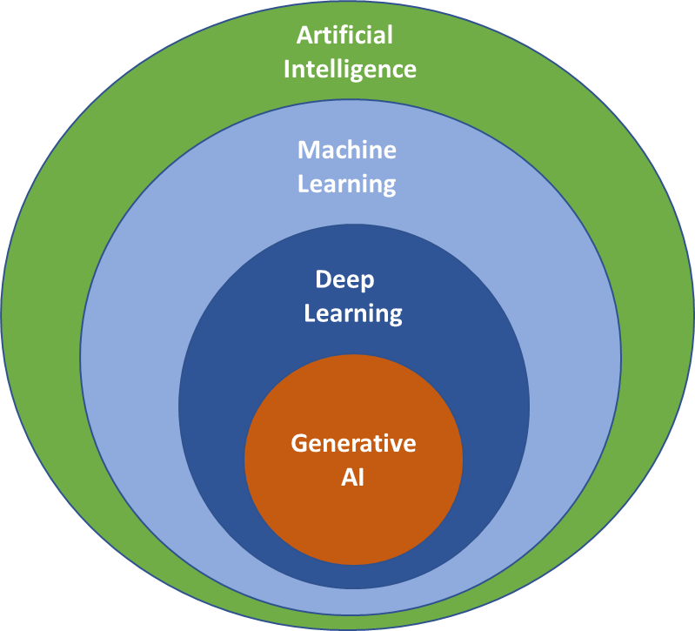
What is Machine Learning and AI?
Machine Learning
Machine Learning (ML) is a branch of AI that enables systems to automatically learn and improve from experience by analyzing data. Instead of being explicitly programmed.
Artificial Intelligence
Artificial Intelligence (AI) is a broader concept which involves creating systems that can perform tasks requiring human intelligence, such as problem- solving and pattern recognition.
Machine Learning is a core component of AI.

Slide 7
Types of Machine Learning
Machine Learning is divided into different types based on how models learn from data. The two main types are:
Supervised Learning
The model is trained on labeled data, where the correct answers are known.
It learns to predict the outcome for new data based on what it has learned.
Example: House Price Prediction, Predicting diseases.
Unsupervised Learning
The model is given unlabeled data and must find patterns or groupings on its own.
It organizes data based on similarities without specific guidance.
Example: Grouping customers by purchasing behavior, clustering movies by genre.

Slide 8
ML: Supervised Machine Learning
Supervised Machine Learning
Supervised Machine Learning is a technique where models are trained on labeled datasets, enabling them to learn the relationship between inputs and outputs for accurate predictions on new data.
Types of Supervised Learning:
Regression: Predicting continuous values (e.g., house prices).
Classification: Predicting categorical labels (e.g., spam or not spam).
Key Features:
Requires labeled data for training.
Algorithms learn from examples to enhance accuracy.

Slide 9
Supervised ML: Regression
Regression
Regression is a type of supervised learning focused on predicting continuous numerical values based on input features. It establishes a relationship between the independent variables (inputs) and the dependent variable (output).
Types of Regression:
Linear Regression: Models the relationship with a straight line (e.g., predicting sales based on advertising spend).
Polynomial Regression: Models relationships using polynomial equations (e.g., predicting growth trends).
Ridge and Lasso Regression: Techniques for regularization to prevent overfitting.
Key Features:
Provides estimates for continuous outcomes.

Slide 10





Evaluating Regression Models
Various metrics are used to determine their accuracy and performance and access how well the model predicts continuous outcomes.
Key Evaluation Metrics:
Mean Absolute Error (MAE): Measures the average absolute differences between predicted and actual values.
Mean Squared Error (MSE): Calculates the average of the squared differences, giving higher weight to larger errors.
Root Mean Squared Error (RMSE): The square root of MSE, providing error in the same units as the output variable.

Slide 11



Types of Regression Model: Linear Regression
Linear Regression is a statistical method used to model the relationship between a dependent variable and one or more independent variables by fitting a linear equation.
Types:
Simple Linear Regression: Models the relationship between one independent variable and the dependent variable.
Multiple Linear Regression: Extends to multiple independent variables.
Cost Function: The model aims to minimize the error between predicted and actual values by reducing the Mean Squared Error (MSE):
Optimization: Optimization refers to the process of finding the best parameters for the model that minimize the cost function. This is achieved using Gradient Descent, which iteratively adjusts the coefficients:
Where J(b) is the cost function (MSE) and α is the learning rate.

Slide 12

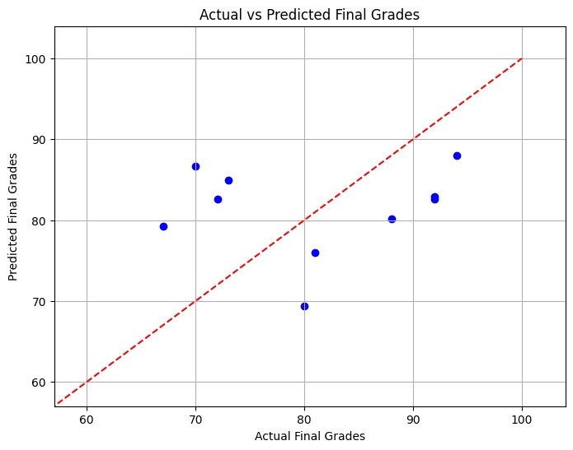
Types of Regression Model: Linear Regression
Scikit-Learn Implementation:

Slide 13

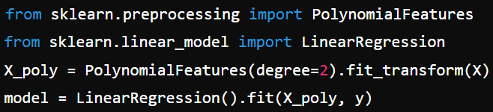
Types of Regression Model: Polynomial Regression
Polynomial Regression is a statistical method used to model the relationship between a dependent variable and one or more independent variables by fitting a polynomial equation.
Types:
Simple Polynomial Regression:
Models the relationship between one independent variable and the dependent variable using polynomial terms.
Multiple Polynomial Regression:
Extends to multiple independent variables using polynomial terms.
Scikit-Learn Implementation:

Slide 14
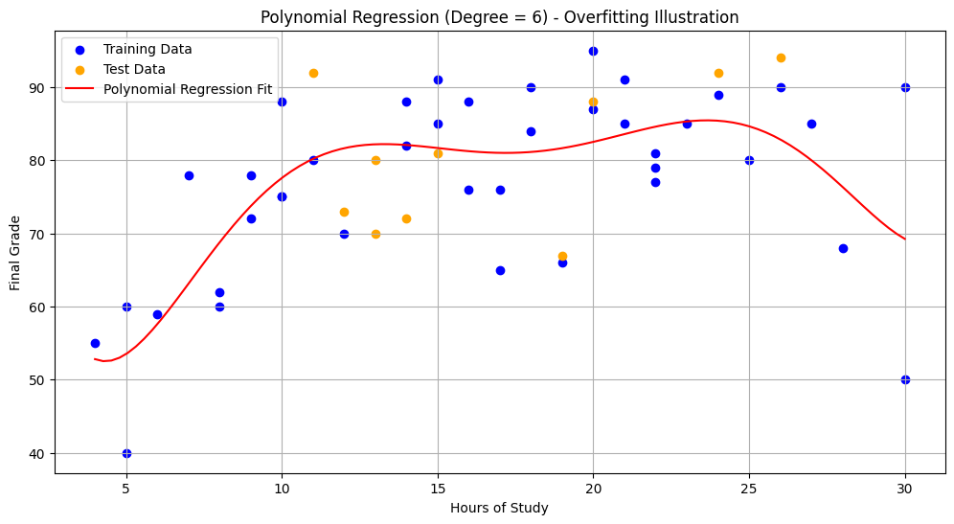
Types of Regression Model: Polynomial Regression

Slide 15

Types of Regression Model: Ridge Regression
Ridge Regression is a statistical method used to model the relationship between a dependent variable and one or more independent variables, incorporating L2 regularization to penalize large coefficients and prevent overfitting.
Motive: Enhances linear regression by adding a regularization term (L2 penalty) to shrink the coefficients.
Cost Function: The model aims to minimize the error between predicted and actual values while adding a penalty for large coefficients, defined as:
Where λ is the regularization parameter, and MSE is the Mean Squared Error.

Slide 16

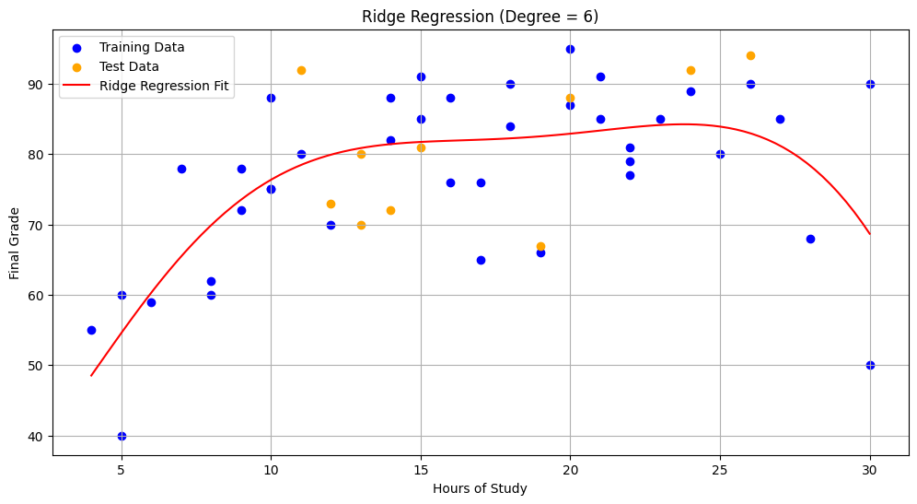
Types of Regression Model: Ridge Regression
Scikit-Learn Implementation:
Linear Regression
BEFORE
Ridge Regression
AFTER

Slide 17

Types of Regression Model: Lasso Regression
Lasso Regression is a statistical method used to model the relationship between a dependent variable and one or more independent variables, incorporating L1 regularization to penalize large coefficients and encourage sparsity in the model.
Motive: Enhances linear regression by adding a regularization term (L1 penalty) to shrink some coefficients to zero, effectively performing variable selection.
Cost Function: The model aims to minimize the error between predicted and actual values while adding a penalty for large coefficients, defined as:
Where λ is the regularization parameter, and MSE is the Mean Squared Error.

Slide 18

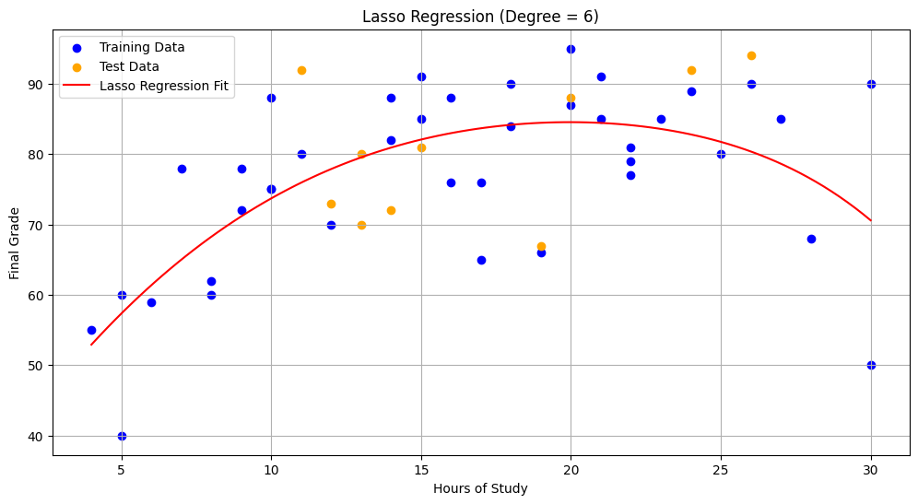
Types of Regression Model: Lasso Regression
Scikit-Learn Implementation:
Linear Regression
BEFORE
Lasso Regression
AFTER

Slide 19
Supervised ML: Classification
Classification
Classification is a type of supervised learning that focuses on predicting categorical labels based on input features. The model learns to assign input data to predefined classes or categories.
Types of Classification:
Binary Classification: Predicting one of two possible classes (e.g., email as spam or not spam).
Multiclass Classification: Predicting one of multiple classes (e.g., classifying images of animals into categories like dog, cat, or bird).
Key Features:
Uses labeled training data to learn class boundaries.

Slide 20





Evaluating Classification Models
Various metrics are used to assess the accuracy and effectiveness of classification models in predicting categorical outcomes and determining their performance on unseen data.
Key Evaluation Metrics:
Accuracy: Proportion of correct predictions made by the model out of total predictions.
Precision: Proportion of true positive predictions among all positive predictions, reflecting the quality of positive class predictions.
Recall (Sensitivity): Proportion of true positive predictions among all actual positive cases, indicating the model's ability to identify positive instances.

Slide 21

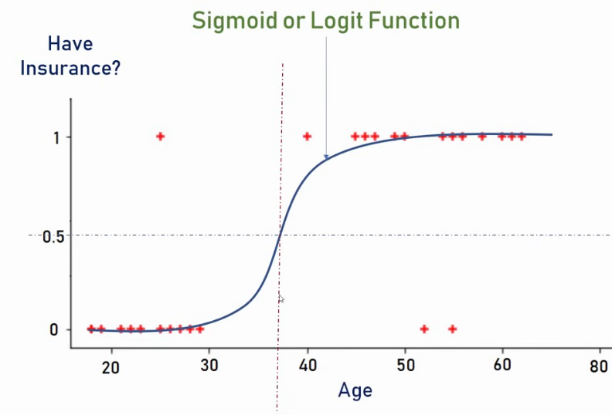

Types of Classification Model: Logistic Regression
Logistic Regression is a method for predicting binary outcomes based on one or more independent variables.
Types:
Binary Logistic Regression: Two possible outcomes.
Multinomial Logistic Regression: More than two outcomes.
Sigmoid Function: The model uses the sigmoid function to map predicted values to probabilities:
Where
(similar to Linear Regression)
Outputs probabilities between 0 and 1.
Scikit-Learn Implementation:

Slide 22
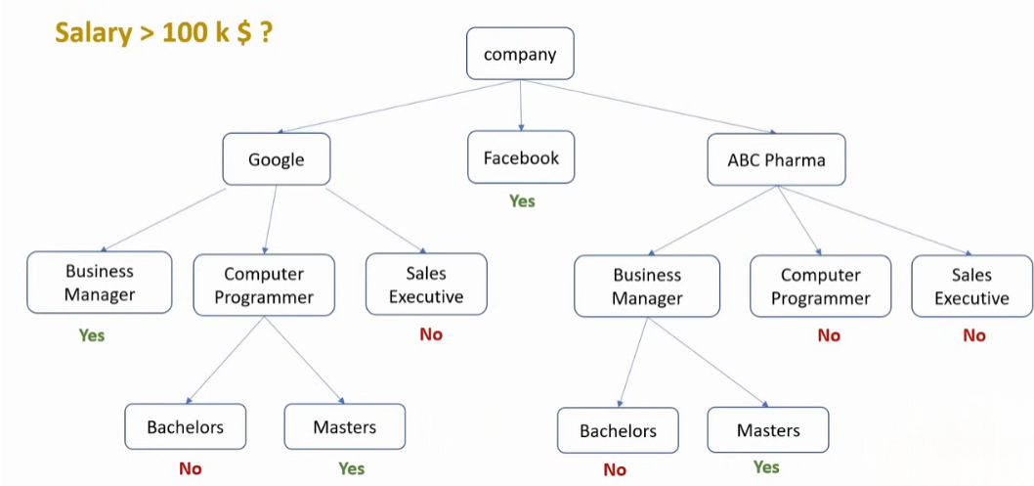

Types of Classification Model: Decision Tree
Decision Tree is a model used for classification tasks that splits data into branches based on feature values.
Key Features: The model makes decisions based on the following:
Nodes: Represent features or attributes.
Branches: Represent decision
rules based on feature values.
Leaves: Represent the final
output or target variable.
Outputs: Produces class labels
as per classifications.
Scikit-Learn Implementation:

Slide 23
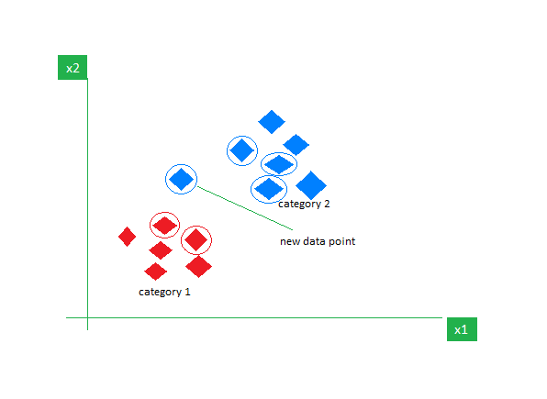

Types of Classification Model: K-Nearest Neighbours
K-Nearest Neighbors (KNN) is a simple, non-parametric algorithm used for classification tasks based on the proximity of data points.
Key Features:
Distance Metric: Typically uses Euclidean distance, calculated as:
Parameter K: The number of nearest neighbors to consider; can impact model performance.
Outputs: Produces class labels based on the majority vote of neighbors.
Scikit-Learn Implementation:

Slide 24
ML: Unsupervised Machine Learning
Unsupervised Machine Learning
Unsupervised Machine Learning is a technique where models are trained on unlabeled data, allowing them to identify patterns and structures without predefined outputs.
Types of Unsupervised Learning:
Clustering: Grouping similar data points (e.g., grouping customers).
Key Features:
Works with data that lacks labels.
Helps in discovering hidden patterns and insights in data.

Slide 25
Unsupervised ML: Clustering
Clustering
Clustering is an unsupervised learning technique focused on grouping similar data points based on their features. It aims to discover inherent structures within the data without pre-defined labels.
Types of Clustering:
K-Means Clustering: Partitions data into K distinct clusters based on feature similarity.
Key Features:
Helps by identifying patterns and structures.
No prior labeling is required, making it suitable for unlabeled datasets.
Useful in various applications, such as customer grouping and image analysis.

Slide 26

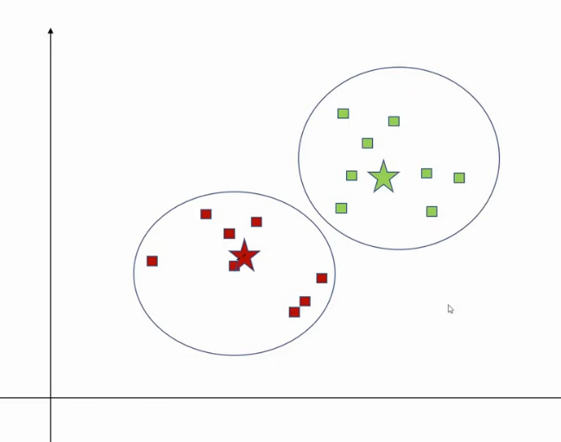

Types of Clustering Model: K-Mean Clustering
K-Means Clustering is a popular unsupervised learning algorithm that partitions data into K distinct clusters based on feature similarity.
Key Steps:
Initialization: Randomly select K initial centroids.
Assignment: Assign each data point to the nearest centroid using the Euclidean distance:
where c represents the coordinates of the centroid.
Update: Calculate the new centroids by averaging the data points in each cluster.
Key Features:
Simple and efficient for large datasets.
Requires specifying the number of clusters (K)
in advance, which can be a limitation.
Scikit-Learn Implementation:

Slide 27
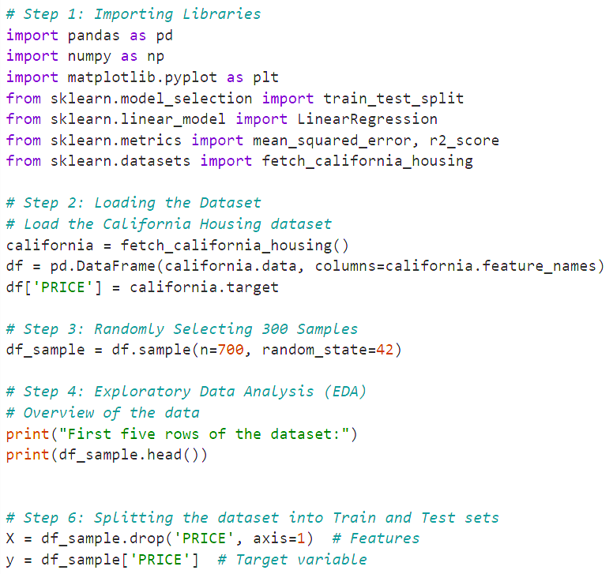
Final Project: CALIFORNIA HOUSE PRICE PREDICTION
Objective: To build a predictive model that estimates California housing prices based on features like location, size, and room count, helping buyers and investors make informed decisions.
Tools Used:
Python: Programming language.
Libraries:
Pandas: Data manipulation.
NumPy: Numerical operations.
Matplotlib: Data visualization.
Scikit-learn: Machine learning.
Process Overview:
Data Loading: California housing dataset.
Data Sampling: Selected 700 samples.
Data Preparation:
Features: All columns except 'PRICE'.
Target: 'PRICE’.

Slide 28
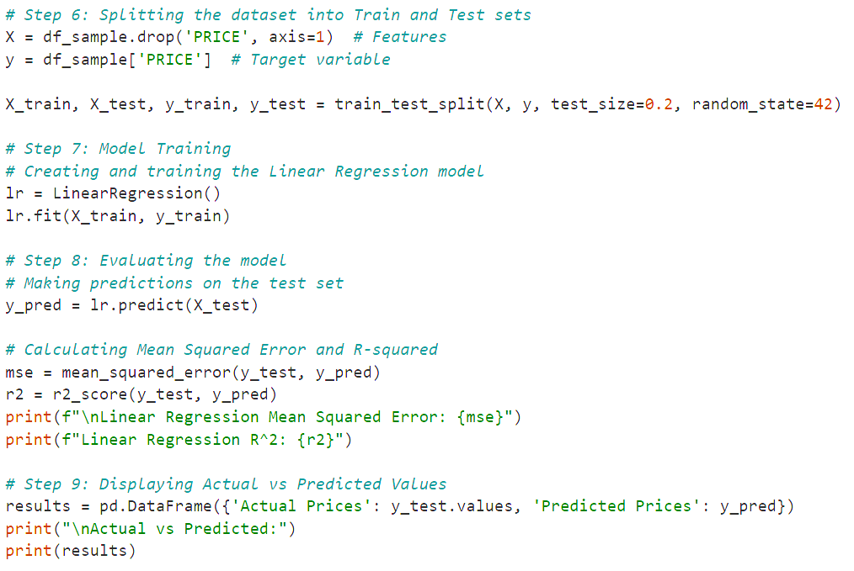

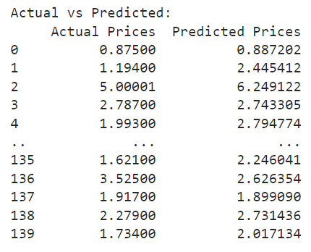
Final Project: CALIFORNIA HOUSE PRICE PREDICTION
Model Training:
Train/Test Split: Split data into training (80%) and testing (20%) sets.
Model Creation: Created a Linear Regression model and trained it using the training data.
Model Evaluation Metrics:
Mean Squared Error (MSE): Measures the average squared difference between actual and predicted prices.
Results:
MSE Score: 0.3699851092128846 (low and good)
Predictions: Generated predictions on the test set.
Actual vs. Predicted Prices:
Comparison Table: Displays the differences between actual and predicted prices.

Slide 29
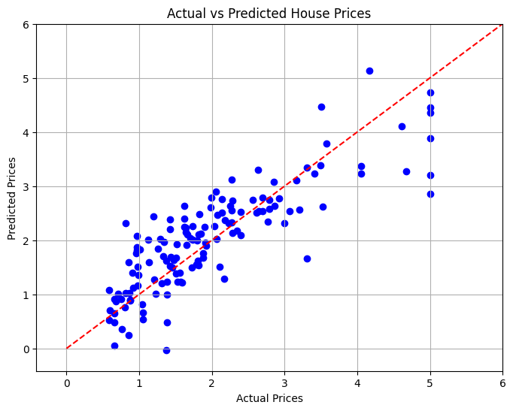
Final Project: CALIFORNIA HOUSE PRICE PREDICTION
Applications of House Price Prediction:
Real Estate Investment: Informs investors about potential property values and investment opportunities.
Home Pricing Strategy: Helps sellers set competitive prices based on market data.
Property Valuation: Enables homeowners to establish fair rates for their properties.
Negotiation Leverage: Empowers buyers to negotiate effectively with agents and sellers using data insights.
--- THANK YOU ---

